Slide 1
Android Graphics and Animation For Beginners
Mihir Gokani, Pushpak Burange

Slide 2
Session Outline
Drawing with Canvas 14:30
View Animation
Property Animation
Break 15:15
Property Animation (Contd…) 15:30
OpenGL ES

Slide 3
Drawing with Canvas
Mihir Gokani

Slide 4
Motivation
2D Drawing
Custom UI
Simple Games
Any 2D Graphics / Animation

Slide 5
How to Draw?
1
2
3
STEP 1: Referencing Canvas
Override onDraw() and get reference of Canvas
Snippet 1: Overriding onDraw()
class MyView extends View {
@Override
void onDraw(Canvas canvas) {
// Do something with canvas
}
}

Slide 6
How to Draw?
1
2
3
STEP 2: Draw
Option 1: Use various drawXXX() methods of the Canvas
Snippet 2: Using Canvas.drawXXX() (CanvasDemo1)
canvas.drawCircle(cx, cy, radius, paint);
canvas.drawRect(left, top, right, bottom, paint);
canvas.drawText(text, posx, posy, paint);

Slide 7
How to Draw?
1
2
3
STEP 2: Draw
Option 2: Use draw() method of a Drawable
Snippet 3: Using Drawable.draw() (CanvasDemo3a,3b)
myShapeDrawable.draw(canvas);

Slide 8
How to Draw?
1
2
3
STEP 3: Redraw!
Call invalidate() or postInvalidate()
Snippet 4: Invalidate example onTouch() (CanvasDemo3c)
ShapeDrawable drawable = new ShapeDrawable(touchShape);
drawable.setBounds((int) e.getX() - 25, (int) e.getY() - 25, (int) e.getX() + 25, (int) e.getY() + 25);
drawables.add(drawable);
invalidate();

Slide 9
How to Draw?
1
2
3
STEP 3: Redraw!
Call invalidate() or postInvalidate()
Only a request
Snippet 5: How NOT to draw
while (y < 500){
drawBallAt(x, y);
y++;
invalidate();
}

Slide 10
How to Draw?
1
2
3
STEP 3: Redraw!
Call invalidate() or postInvalidate()
Only a request
Snippet 6: How to draw (CanvasDemo4c)
new Thread(new Runnable() {
public void run() {
while (y < 500){
drawBallAt(x, y);
y++;
postInvalidate();
}
}
}

Slide 11
Paint
Change Color
Change Style
For both Shapes and Text
Snippet 7: Paint
setColor() // Color -> int
setFlags() // Dithering, Anti-alias
setTextSize() // float
setTextAlign() // Align enum

Slide 12
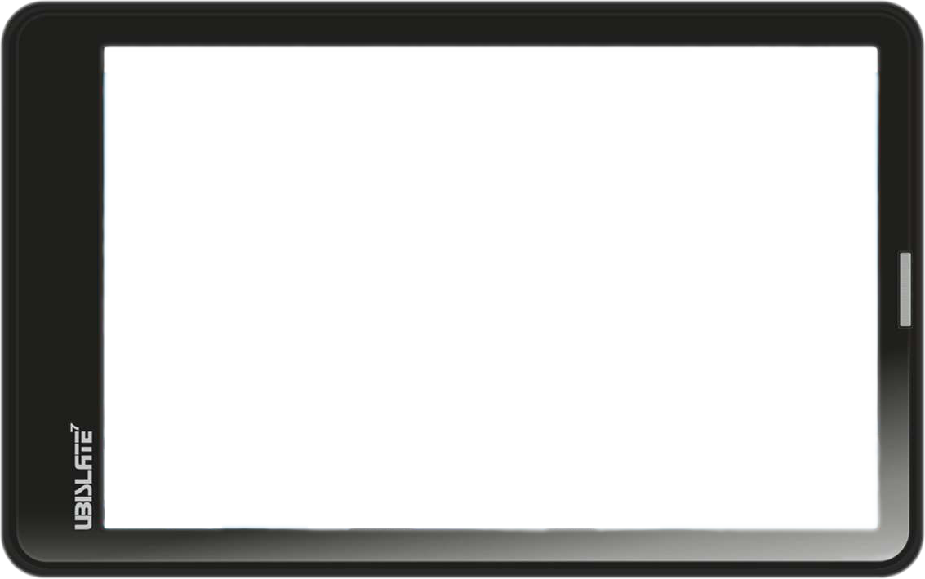
Coordinate System
View

Slide 13
Coordinate System
(0, 0)
5
10
X
5
Y

Slide 14
Coordinate System
(0, 0)
5
10
X
5
Y

Slide 15
Coordinate System
(0, 0)
5
10
X
(9, 4)
5
Y

Slide 16
Coordinate System (Advanced)
Translating multiple objects
(0, 0)
5
10
X
(9, 4)
5
Y

Slide 17
Coordinate System (Advanced)
Translating multiple objects
(0, 0)
5
10
X
(9, 4)
5
Y

Slide 18
Coordinate System (Advanced)
Translating multiple objects
(0, 0)
5
10
X
(9, 4)
5
Y

Slide 19
Coordinate System (Advanced)
Translating multiple objects
(0, 0)
X
(0, 0)
5
10
X
5
Y
Y

Slide 20
Coordinate System (Advanced)
Translating multiple objects
(0, 0)
X
(0, 0)
5
10
X
(9, 4)
5
Y
Y

Slide 21
Coordinate System (Advanced)
Translating multiple objects
(0, 0)
X
(0, 0)
5
10
X
(9, 4)
5
Y
Y

Slide 22
Coordinate System (Advanced)
Rotating multiple objects
(0, 0)
(0, 0)
5
10
X
X
(9, 4)
5
Y
Y

Slide 23
Coordinate System (Advanced)
Rotating multiple objects
(0, 0)
X
5
10
X
(9, 4)
5
Y
Y

Slide 24
Coordinate System (Advanced)
Rotating multiple objects
X
(0, 0)
5
10
X
(9, 4)
5
Y
Y

Slide 25
How to Draw? (Advanced)
Transforming multiple objects
Snippet 7
canvas.save(); // <-- LINE A
canvas.rotate(0f);
drawBallAt(50f, 0f); // Blue Ball
drawBallAt(100f, 0f); // Red Ball
canvas.restore(); // <-- LINE A
drawBallAt(150f, 0f); // Green Ball

Slide 26
How to Draw? (Advanced)
Transforming multiple objects
Snippet 8
canvas.save(); // <-- LINE A
canvas.rotate(15f);
drawBallAt(50f, 0f); // Blue Ball
drawBallAt(100f, 0f); // Red Ball
canvas.restore(); // <-- LINE B
drawBallAt(150f, 0f); // Green Ball

Slide 27
How to Draw? (Advanced)
Define drawables in XML
File: “res/drawable/filename.xml”
Datatype: GradientDrawable
Use in Java: R.drawable.filename
Use in XML: “@drawable/filename”
REF: http://d.android.com/guide/topics/resources/drawable-resource.html#Shape

Slide 28
How to Draw? (Advanced)
Use in XML / Java
Snippet 9
<TextView
android:background="@drawable/gradient"
android:layout_height="wrap_content"
android:layout_width="wrap_content" />
Snippet 10
Resources res = getResources();
Drawable d = res.getDrawable(R.drawable.gradient);
textView.setBackground(d);

Slide 29
View Animation
Pushpak Burange

Slide 30
What is animation?
Animation is the rapid display of a sequence of images to create an illusion of movement
Example of animations:
Games, Cartoons etc.
Used for animating algorithms, science experiments to help students understand better

Slide 31
More on Animation
Various types of Animation
View Animation,
Property Animation,
Canvas and Drawable Animation,
OpenGL
We’ll talk about View Animation

Slide 32
View Animation
Adding animation to Android Views such as TextViews
Rotate Text, Translate Text, Change color etc.
After the basics, you are encouraged to explore more

Slide 33
Getting Started
Animations on views are defined in XMLs.
The animation XML file belongs in the “res/anim/” directory of your Android project.

Slide 34
Animation Class
For performing animations on views, we need an object of Animation class
The animation information is stored inside the Animation object

Slide 35
Defining an Animation Object
Here, a is the object of Animation class
R.anim.translate is the “translate.xml” which specifies the translation to be applied
Snippet 1: Loading Animation
Animation a = AnimationUtils.loadAnimation( this, R.anim.translate);

Slide 36
Animation on TextViews
Here, translateText is a TextView
Calling this API will translate the TextView according to the XML
Snippet 2: Starting Animation
translateText.startAnimation(a);

Slide 37
Triggering Multiple animations
Set an AnimationListener
AnimationListener has three methods:
onAnimationStart()
onAnimationRepeat()
onAnimationEnd()

Slide 38
Triggering Multiple animations
It is possible to animate multiple views one after the other on a single click
To animate recursively, call startAnimation() inside onAnimationEnd()

Slide 39
Summary
Creating XML
Creating Animation object
Applying animation to View

Slide 40
Property Animation
Mihir Gokani

Slide 41
View vs. Property Animation
View Animation | Property Animation
Specifically for views | ANY object (including views ⁺)
Only few properties | Any property ⁺⁺
Only drawing of views, Not the actual view itself! | Any property of view and drawables
Less code to write | More code to write #
android.view.animation.* | android.animation.*

Slide 42
Class Hierarchy
Animator +AnimationListener
ValueAnimator
+AnimationUpdateListener
AnimatorSet
ObjectAnimator

Slide 43
Animator
Since API 11 (Android 3.0)
Duration and Start delay
Repeat count and Reverse behaviour
Time interpolation and Type evaluation
Animation Listener

Slide 44
Animator
Since API 11 (Android 3.0)
Time interpolation and Type evaluation
We specify start / end values, duration
Animator computes values in [0, 1] uniformly over duration (PROGRESS)
Animator uses TimeInterpolator to tweak the progress (FRACTION)
Animator uses TypeEvaluator to map normalized fraction to appropriate VALUE for given start / end values

Slide 45
Animator
Since API 11 (Android 3.0)
Time Interpolators:
Built-in: Linear, Accelerate, Decelerate, Anticipate, Overshoot, Bounce, Cycle, …
Custom
Current Animation Progress
getInterpolation()
Interpolated FRACTION
Float value between 0 (start of animation) and 1.0 (end of animation)
Can be less than 0 (for undershooting) or can be more than 1.0 (for overshooting)

Slide 46
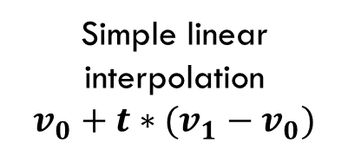
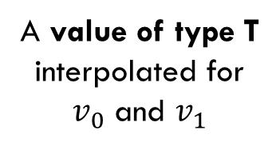

Animator
Since API 11 (Android 3.0)
Type Evaluators:
Built-in: Float, Int, Argb
Custom
Interpolated Fraction, Start value, End value
evaluate()
Animated VALUE
$t$: Float value (not necessarily in [0, 1.0]) $v_{0}$, $v_{1}$: Values of type T
Simple linear interpolation
$$v_{0}+t∗(v_{1}−v_{0})$$
A value of type T interpolated for $v_{0}$ and $v_{1}$

Slide 47
Animator
Since API 11 (Android 3.0)
Elapsed Time (ms) | Current Progress for 1000ms | Linear
 |  | Interpltd Fraction (float) | Computed Value [100, 300]
0 | 0.0 | 0.0 | 100.0
200 | 0.2 | 0.2 | 140.0
400 | 0.4 | 0.4 | 180.0
600 | 0.6 | 0.6 | 220.0
800 | 0.8 | 0.8 | 260.0
1000 | 1.0 | 1.0 | 300.0
(OUTPUT)
Fraction / Value
1
(INPUT)
Current
Progress
0
1.0

Slide 48
Animator
Since API 11 (Android 3.0)
Elapsed Time (ms) | Current Progress for 1000ms | Accel.-Decelerate
 |  | Interpltd Fraction (float) | Computed Value [100, 300]
0 | 0.0 | 0.0 | 100.0
200 | 0.2 | 0.1 | 120.0
400 | 0.4 | 0.345 | 169.0
600 | 0.6 | 0.8 | 260.0
800 | 0.8 | 0.9 | 280.0
1000 | 1.0 | 1.0 | 300.0
(OUTPUT)
Fraction / Value
1
(INPUT)
Current
Progress
0
1.0

Slide 49
Animator
Since API 11 (Android 3.0)
Elapsed Time (ms) | Current Progress for 1000ms | Anticipate-Overshoot
 |  | Interpltd Fraction (float) | Computed Value [100, 300]
0 | 0.0 | 0.0 | 100.0
200 | 0.2 | -0.112 | 77.6
400 | 0.4 | 0.064 | 112.8
600 | 0.6 | 0.936 | 287.2
800 | 0.8 | 1.112 | 322.4
1000 | 1.0 | 1.0 | 300.0
(OUTPUT)
Fraction / Value
1
(INPUT)
Current
Progress
0
1.0

Slide 50
Animator
Demo
Linear
Accelerate-Decelerate
Anticipate-Overshoot

Slide 51
Animator
Since API 11 (Android 3.0)
Animation Listeners
Snippet 1
animation.addListener( new Animator.AnimatorListener() {
public void onAnimationStart(Animator a) {}
public void onAnimationRepeat(Animator a) {}
public void onAnimationCancel(Animator a) {}
public void onAnimationEnd(Animator a) {}
});

Slide 52
Value Animator
Since API 11 (Android 3.0)
Working
We specify start / end values, duration
Animator computes values in [0, 1] uniformly over duration (PROGRESS)
Animator uses TimeInterpolator to tweak the progress (FRACTION)
Animator uses TypeEvaluator to map normalized fraction to appropriate VALUE for given start / end values

Slide 53
Value Animator
Since API 11 (Android 3.0)
Working
We specify start / end values, duration
Animator computes values in [0, 1] uniformly over duration (PROGRESS)
Animator uses TimeInterpolator to tweak the progress (FRACTION)
Animator uses TypeEvaluator to map normalized fraction to appropriate VALUE for given start / end values

Slide 54
Value Animator
Since API 11 (Android 3.0)
Working
We specify start / end values, duration
We listen to the update event
Animator computes values in [0, 1] uniformly over duration (PROGRESS)
We get the animated VALUE
We then use it in any way we want

Slide 55
Value Animator
Since API 11 (Android 3.0)
Working
We specify start / end values, duration
We listen to the update event
Animator computes values in [0, 1] uniformly over duration (PROGRESS)
We get the animated VALUE
We then use it in any way we want

Slide 56
Value Animator
Since API 11 (Android 3.0)
Animation Update Listener
Snippet 2: Animation Update Listener (AnimatorDemo1)
animation.addUpdateListener( new ValueAnimator.AnimatorUpdateListener() {
public void onAnimationUpdate(ValueAnimator a){ // do something when the value is updated
Float value = (Float) animation.getAnimatedValue();
// Use “value” e.g. for animation
}
});

Slide 57
Object Animator
Since API 11 (Android 3.0)
Example
Snippet 3: Object Animator
MyObject o = new MyObject();
// ...
// Later...
// Assuming MyObject has defined properties // “float getProp()” and “setProp(float)”
ObjectAnimator anim = ObjectAnimator.ofFloat(o, “prop", 0f, 250f);
anim.setDuration(1000);
anim.start();

Slide 58
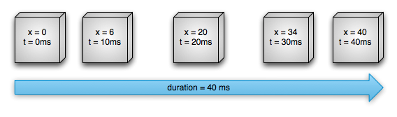
Keyframed Animation
Since API 11 (Android 3.0)
Manual mapping between animation progress and computed value

Slide 59
Animator Set
Since API 11 (Android 3.0)
Group any animators (play())
Specify timeline relations (before(), after(), with())
Start the animation (start())

Slide 60
Animator Set
Since API 11 (Android 3.0)
Example
Snippet 4: AnimatorSet
ObjectAnimator animX = ObjectAnimator.ofFloat(myView, "x", 50f); ObjectAnimator animY = ObjectAnimator.ofFloat(myView, "y", 100f);
AnimatorSet animSetXY = new AnimatorSet(); animSetXY.playTogether(animX, animY);
animSetXY.start();

Slide 61
Animation in XML
Save in “res/animator/” directory (vs. “res/anim/”)
Correspondence
ValueAnimator <animator>
ObjectAnimator <objectAnimator>
AnimatorSet <set>

Slide 62
Animation in XML
Snippet 5: Animator in XML
<set android:ordering=“together”>
<objectAnimator valueType=“floatType” propertyName=“x” valueTo=“50” />
<objectAnimator valueType=“floatType” propertyName=“y” valueTo=“100” />
</set>
Snippet 6: Loading Animator
AnimatorSet set = (AnimatorSet)AnimatorInflater.loadAnimator( myContext, R.anim.property_animator);
set.setTarget(myView);

Slide 63
View Property Animator
Since API 12 (Android 3.1)
While animating a view, if number of aimated properties gets too large
Internally uses Animator
Snippet 7: ViewPropertyAnimator (AnimatorDemo2)
myView.animate().x(50f).y(100f);

Slide 64
OpenGL ES
Pushpak Burange

Slide 65
OpenGL ES
Knowledge of linear algebra and matrix theory is useful
Uses
3D Drawing
3D Games
Any 3D Graphics / Animation
Live Wallpaper (LWP)

Slide 66
OpenGL ES
3D Graphics
Creating a 3D scene
Play with camera
Projection views
Texture mapping
Lighting
Shading

Slide 67
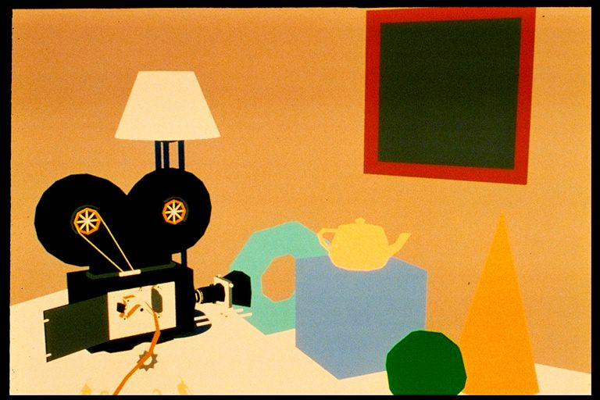
A Scene

Slide 68
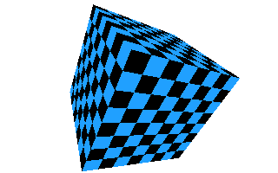
Texture Mapping

Slide 69
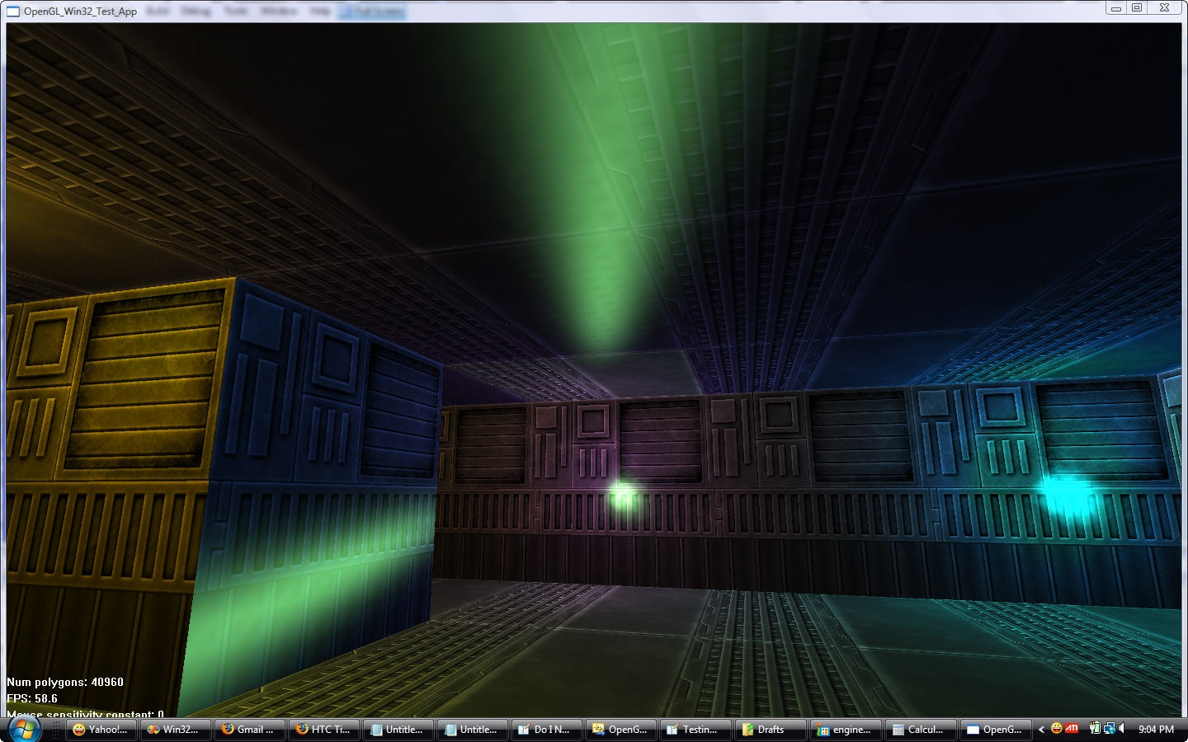
Lighting

Slide 70
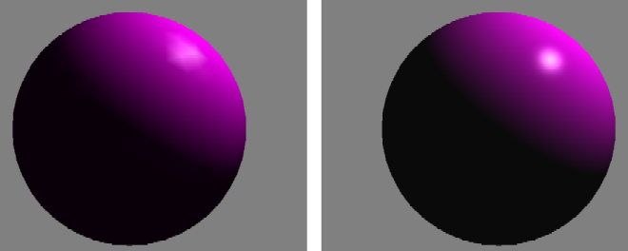
Shading

